Slide 2

Educational Consortium OSAO (VET)
Educational Consortium OSAO (VET) is a leading educational community of vocational experts in Finland, providing work life skills and continuous learning.
OSAO consists of:
  8 education units
  OSAO Edu Ltd

Slide 3
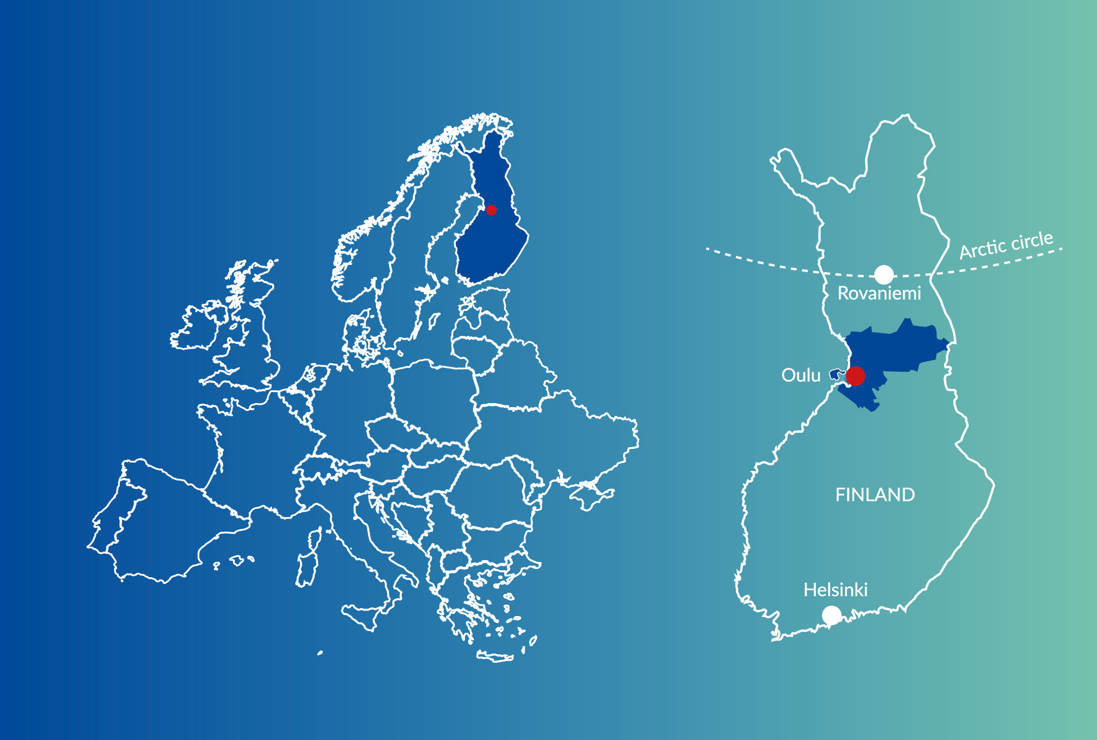
Education units
OSAO’s education units are located in Haukipudas, Oulu, Kempele, Liminka, Muhos, Pudasjärvi and Taivalkoski.
    Oulu–Helsinki 540 km
    Oulu–Rovaniemi 166 km

Slide 4


Work life skills and continuous learning
We arrange vocational education and training in all vocational fields and for all age groups.
​
We develop and provide educational services in cooperation with the working life.

Slide 5

Vocational Fields at OSAO
Humanities and Arts
Agriculture and Forestry
Business and Administration
Health and Welfare
Technology
Service Industries
Information and Communications Technologies (ICTs)

Slide 6


Slide 7

International OSAO
The focus in the international activity of OSAO is in internationalization at home and study periods in companies abroad.
The mobility periods of students and staff are mostly directed towards Europe.
OSAO supports the students’ periods abroad financially as well as with Erasmus+ project funds and OSAO’s own funding.

Slide 8


Global cooperation
Global network of OSAO enables wide range of international activities, such as student and staff mobilities, virtual mobilities, international VET projects, International skills-competitions, and education export.
Partners around Europe

Slide 9
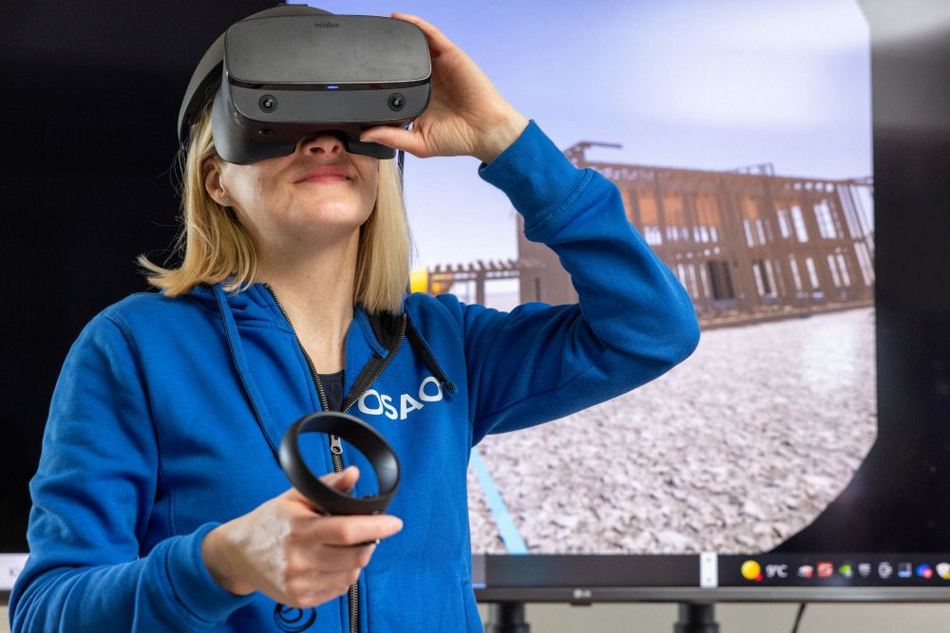
International projects
Our main goal of international projects is to enchance professional skills and supporting life-long learning.
International projects enable development work with our foreign partners. We also support many of our student and professional mobility periods with the help of project funding.
We have experience of coordinating and participating as partner in Erasmus+, Leonardo da Vinci, Comenius and Nordplus projects.

Slide 10

Preparatory Education for Vocational Training TUVA
Immigrant students can complete a short period of pre-vocational preparatory education.
The programme helps to improve Finnish language skills and other abilities needed for studying.
Finnish students can improve their basic education grades, consider a suitable profession, and strengthen their study skills.

Slide 11


IB Career- related Programme
OSAO is an authorized IB World School, Career-related Programme (CP).
OSAO is offering a study programme in business delivered completely in English.
This program is for those who have completed basic education with a good command in the English language.

Slide 12
Tailored Visits and Training
OSAO Edu Ltd

Slide 13


Global Education Services
Let us be your partner in education.
We arrange education services and visits together with our wide network to all who are interested in Finnish vocational education.
We provide education and training both in
Finland and abroad.

Slide 14


Tailored Visits and Training in Various Fields
• Humanities and Arts
• Business and Administration
• Health and Welfare
• Technology
• Service Industries
• Information and Communications Technologies
(ICTs)

Slide 15


Visit and training packages
Packages for professionals
OSAO Edu provides training packages on behalf of OSAO in a wide range of fields.
Packages for students
OSAO Edu provides the opportunity to study in OSAO with local students and experience the Finnish lifestyle.

Slide 16
The Finnish Education System

Slide 17




THE FINNISH EDUCATION SYSTEM provides open pathways to higher and further education.
Source: The Ministry of Education and Culture

Slide 18

Vocational education and training (VET) in Finland is competency-based
In Finland, students who have completed basic education choose their upper secondary pathway, general or VET.
Both pathways are equal in value and provide access to further studies.
Around half of the students completing their basic education continue to VET.
In Finland, each young person must apply for post-comprehensive school education.
Compulsory education ends when the person reaches the age of 18 or when they complete an upper secondary qualification.

Slide 19

Reasons that make VET an attractive choice
Qualified and competent teachers
Flexible national qualifications requirements
Strong employment prospects
Eligibility for further studies
Qualifications allow for employer-specific, regional and personal adaptations
Developed and delivered in cooperation with the working life

Slide 20
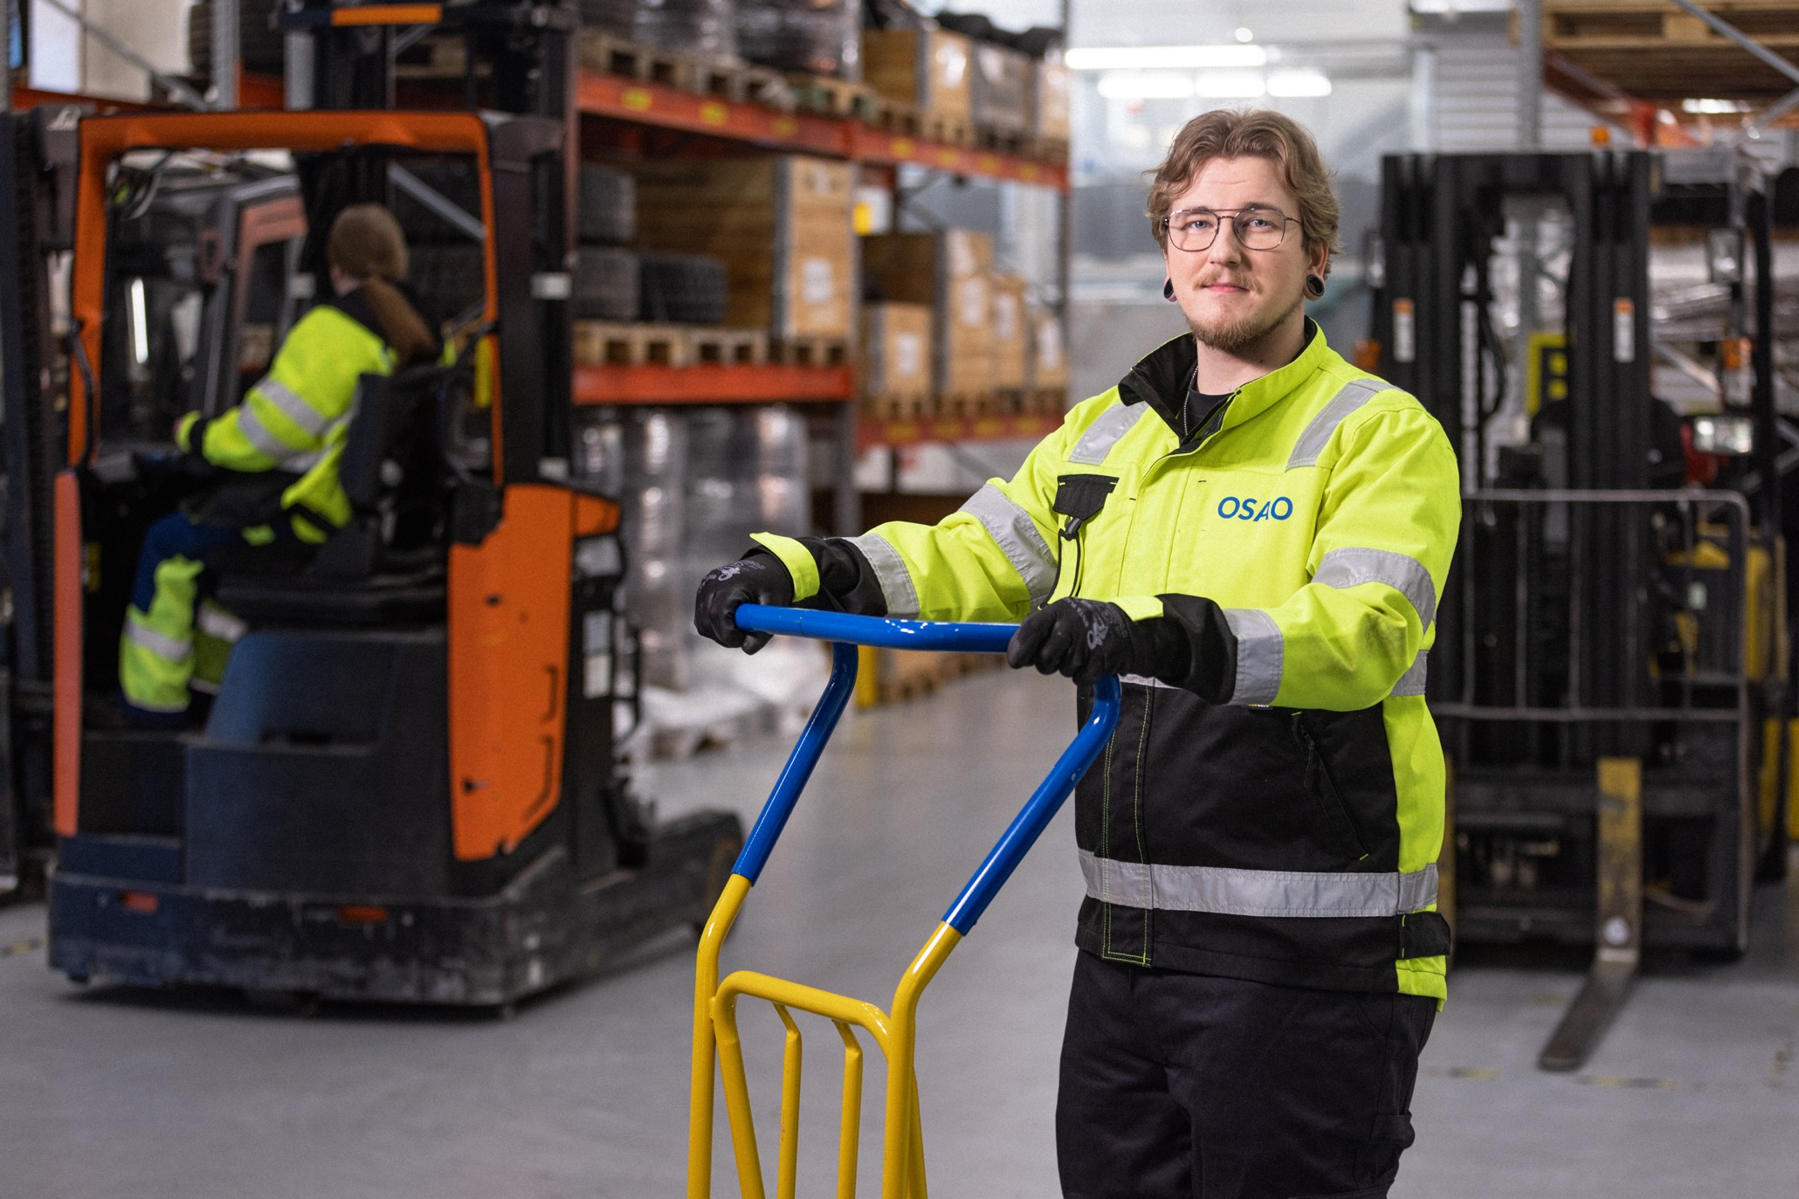
VET – students and working life as clients
Increases and maintains the vocational skills of the population
Develops commerce and industry and responds to its competency needs
Supports lifelong learning and students’ development
Provides students with knowledge and skills necessary in further studies
Promotes employment

Slide 21

VET covers all sectors of working life
The three biggest sectors are:
  Engineering, Manufacturing and Construction
  Business and Administration
  Health and Welfare

Slide 22

Education is free for EU and EEA citizens
National and local government are responsible for financing VET as part of the state budget.
Also VET organised at workplaces is publicly funded.
Students are entitled to a free meal and school transport subsidies.

Slide 23


Facts about Oulu
Facts about Finland
Pristine lakes – there are around 188,000 lakes in the country.
Finland has been judged to be the happiest country in the world.
Around one-third of Finnish adults have an academic degree
The average age of the population is 38.
Finland’s air and nature are pure, and the quality of water resources are the best in the world.

Slide 24



Facts about Oulu
Oulu is a world-class centre of excellence in:
  5G and beyond
  startups
  future health
  international education
Oulu is ranked among the 13 smartest cities in the world. Up to 2.6 billion people use technologies developed in Oulu every day.
Oulu is the European Capital
of Culture in 2026

Slide 25
osao.fi

